Slide 1

Life Expectancy and GDP
[ 3.14 ]
Lucas Vianna
Felix Poley
Dan T Do

Slide 2

ourworldindata.org

Slide 3


Slide 4
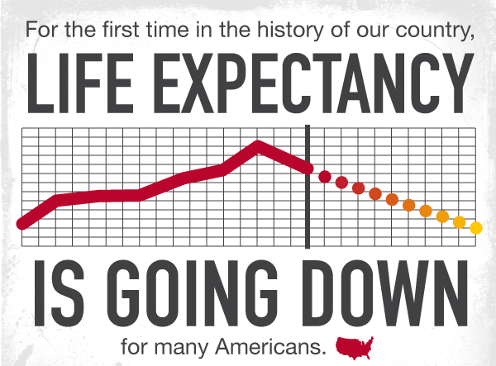

Slide 5
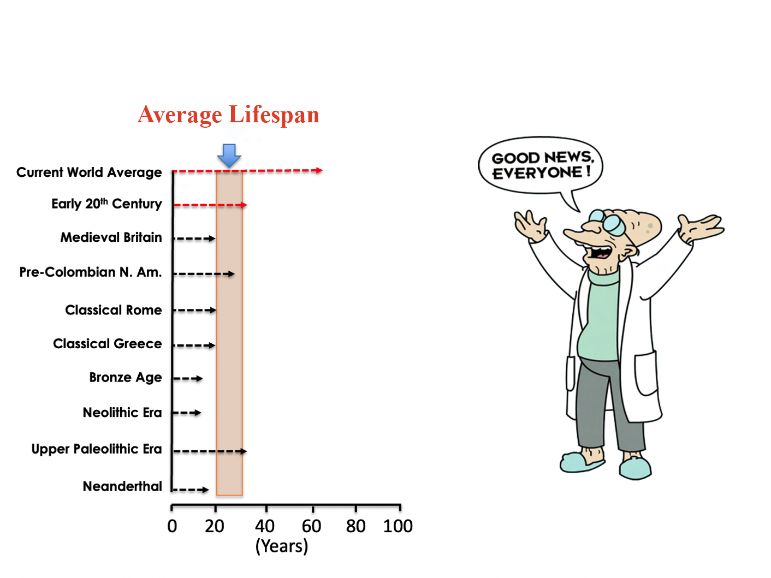

Slide 6

We are living far longer than our forebears …

Slide 7
United States of America

Slide 8
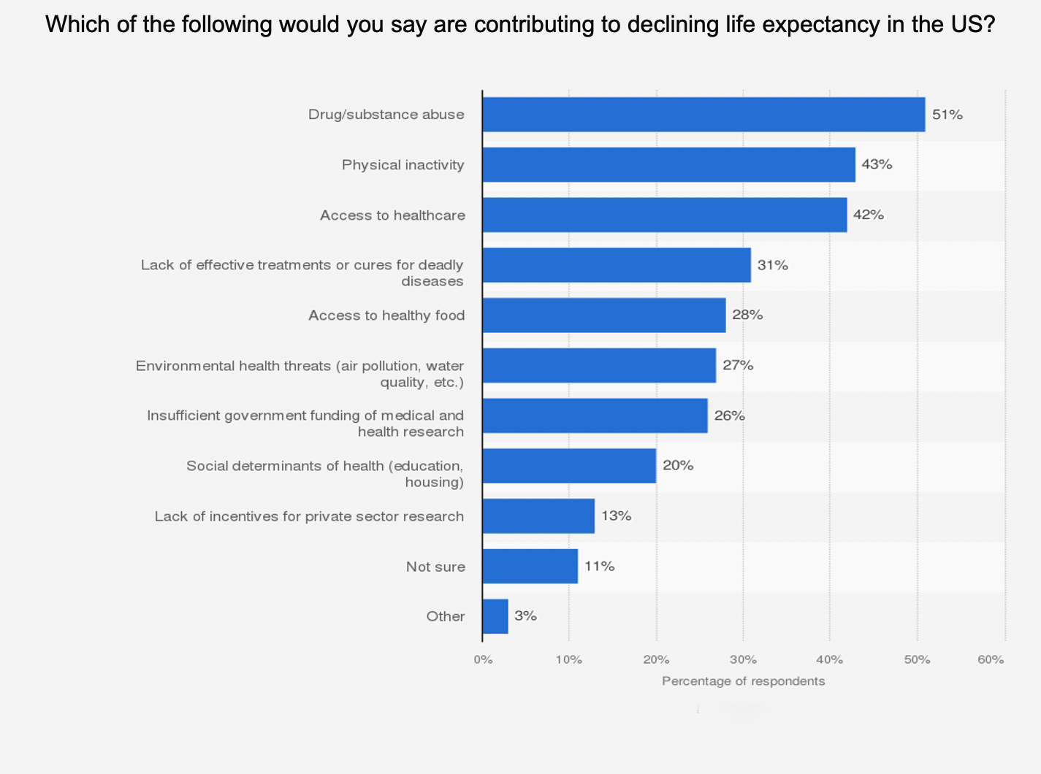

Slide 9


Do you know … ?
Medicine has extended our life expectancy.

Slide 10

What is Gross Domestic Product (GDP)?
GDP is the monetary value of all goods and services produced in a country in a year. It provides a snapshot of economic strength and growth rates.
The 5 countries with the largest GDP in 2020 were:
1. United States
2. China
3. Japan
4. Germany
5. United Kingdom

Slide 11

Inspiring Life Expectancy vs. GDP Data Visualizations

Slide 12
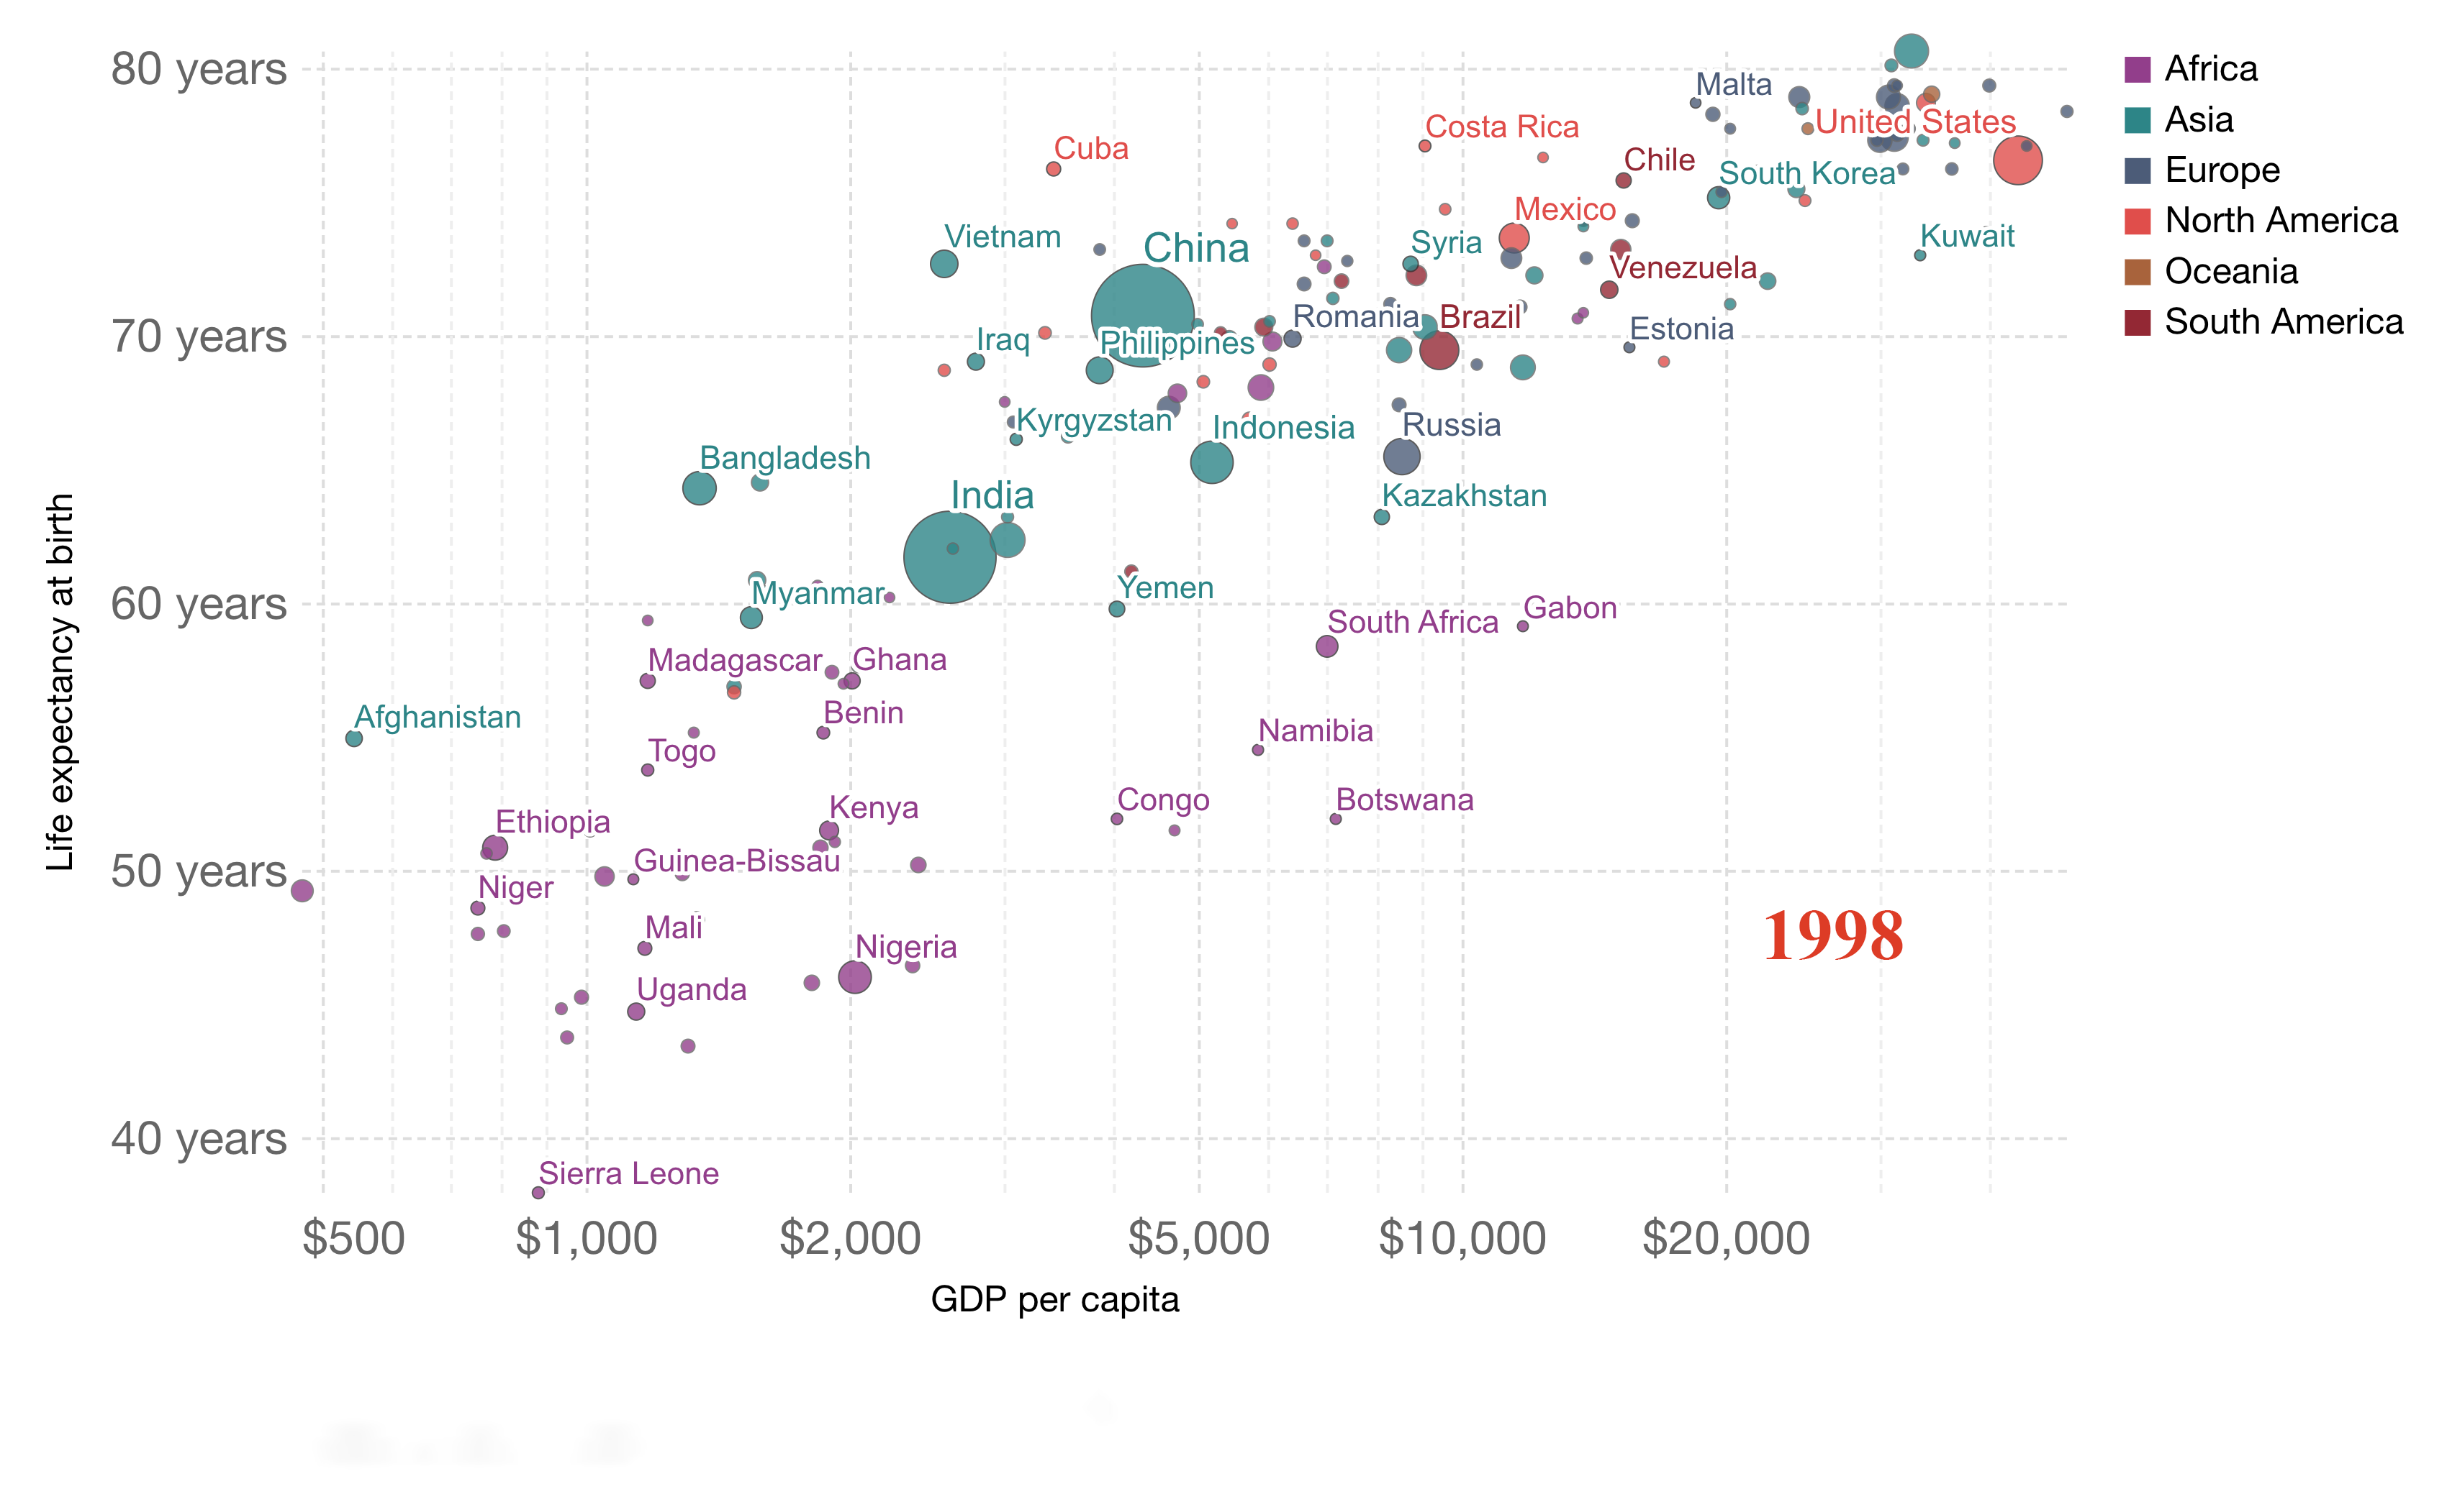

Slide 13
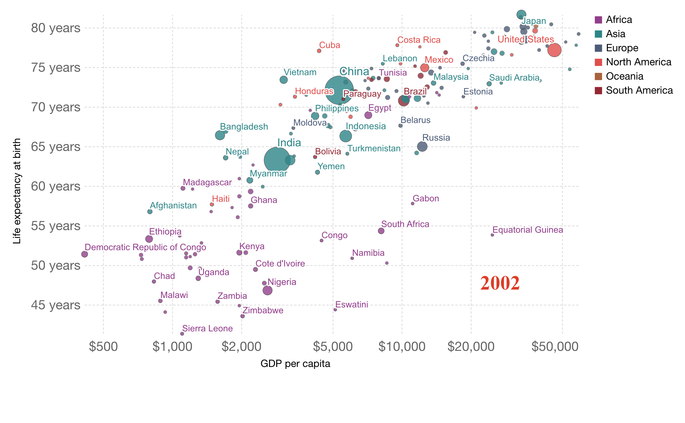

Slide 14
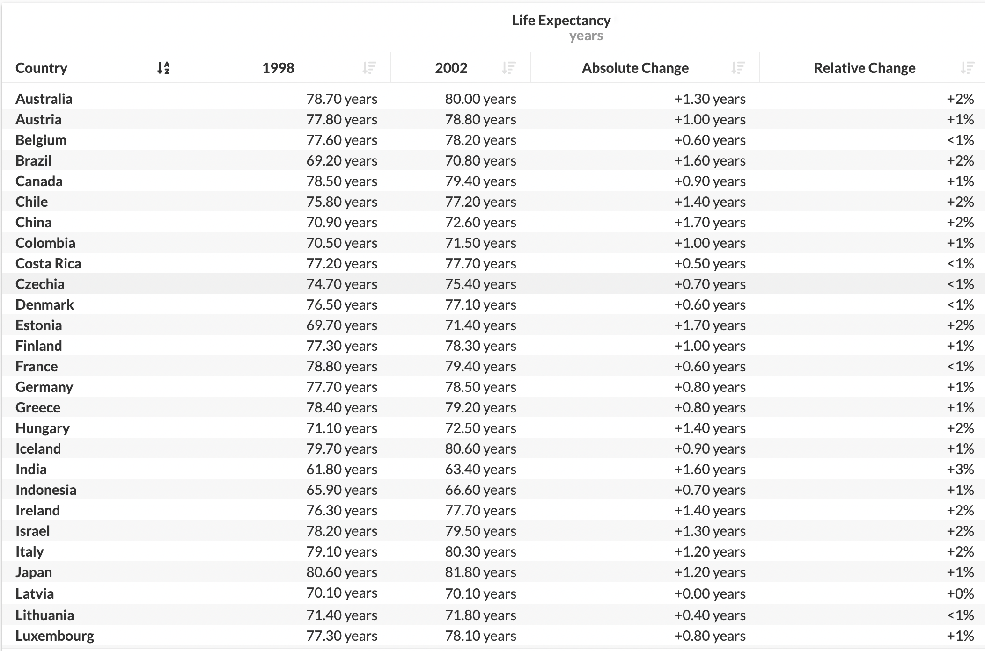

Slide 16
Thank You !

